Slide 1
Divide-and-Conquer Technique

Slide 2
Divide-and-Conquer
Divide-and-Conquer is a general algorithm design paradigm:
Divide the problem into a number of subproblems that are smaller instances of the same problem
Conquer the subproblems by solving them recursively
Combine the solutions to the subproblems into the solution for the original problem
The base case for the recursion are subproblems of constant size
Analysis can be done using recurrence equations

Slide 3
Divide-and-Conquer
We will discuss the following problems
Merge sort
Find maximum and minimum
Find maximum subarray

Slide 4
Divide-and-Conquer Technique: Merge Sort

Slide 5
Merge Sort and Quick Sort
Two well-known sorting algorithms adopt this divide-and-conquer strategy
Merge sort
Divide step is trivial – just split the list into two equal parts
Work is carried out in the conquer step by merging two sorted lists

Slide 6
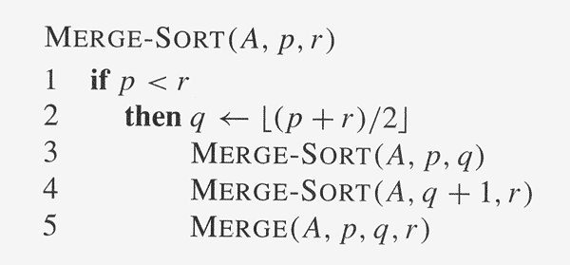
Merge Sort: Algorithm

Slide 7
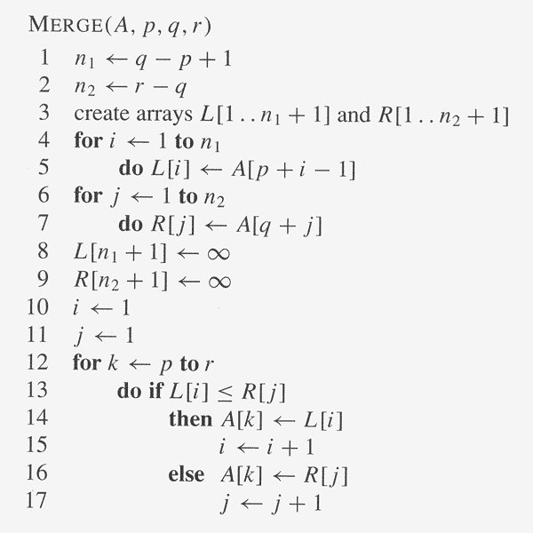
Merge Sort: Algorithm

Slide 8
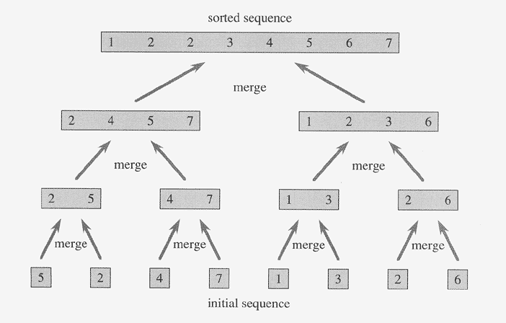
Merge Sort: Example

Slide 9
Execution Example
Partition
7 2 9 4 ⏐ 3 8 6 1 → 1 2 3 4 6 7 8 9
7 2 9 4 → 2 4 7 9
3 8 6 1 → 1 3 8 6
7 2 → 2 7
9 4 → 4 9
3 8 → 3 8
6 1 → 1 6
7 → 7
2 → 2
9 → 9
4 → 4
3 → 3
8 → 8
6 → 6
1 → 1
Merge Sort
9

Slide 10
Execution Example
Recursive call, partition
7 2 9 4 ⏐ 3 8 6 1 → 1 2 3 4 6 7 8 9
7 2 ⏐ 9 4 → 2 4 7 9
3 8 6 1 → 1 3 8 6
7 2 → 2 7
9 4 → 4 9
3 8 → 3 8
6 1 → 1 6
7 → 7
2 → 2
9 → 9
4 → 4
3 → 3
8 → 8
6 → 6
1 → 1
Merge Sort
10

Slide 11
Execution Example
Recursive call, partition
7 2 9 4 ⏐ 3 8 6 1 → 1 2 3 4 6 7 8 9
7 2 ⏐ 9 4 → 2 4 7 9
3 8 6 1 → 1 3 8 6
7 ⏐ 2 → 2 7
9 4 → 4 9
3 8 → 3 8
6 1 → 1 6
7 → 7
2 → 2
9 → 9
4 → 4
3 → 3
8 → 8
6 → 6
1 → 1
Merge Sort
11

Slide 12
Execution Example
Recursive call, base case
7 2 9 4 ⏐ 3 8 6 1 → 1 2 3 4 6 7 8 9
7 2 ⏐ 9 4 → 2 4 7 9
3 8 6 1 → 1 3 8 6
7 ⏐ 2 → 2 7
9 4 → 4 9
3 8 → 3 8
6 1 → 1 6
7 → 7
2 → 2
9 → 9
4 → 4
3 → 3
8 → 8
6 → 6
1 → 1
Merge Sort
12

Slide 13
Execution Example
Recursive call, base case
7 2 9 4 ⏐ 3 8 6 1 → 1 2 3 4 6 7 8 9
7 2 ⏐ 9 4 → 2 4 7 9
3 8 6 1 → 1 3 8 6
7 ⏐ 2 → 2 7
9 4 → 4 9
3 8 → 3 8
6 1 → 1 6
7 → 7
2 → 2
9 → 9
4 → 4
3 → 3
8 → 8
6 → 6
1 → 1
Merge Sort
13

Slide 14
Execution Example
Merge
7 2 9 4 ⏐ 3 8 6 1 → 1 2 3 4 6 7 8 9
7 2 ⏐ 9 4 → 2 4 7 9
3 8 6 1 → 1 3 8 6
7 ⏐ 2 → 2 7
9 4 → 4 9
3 8 → 3 8
6 1 → 1 6
7 → 7
2 → 2
9 → 9
4 → 4
3 → 3
8 → 8
6 → 6
1 → 1
Merge Sort
14

Slide 15
Execution Example
Recursive call, …, base case, merge
7 2 9 4 ⏐ 3 8 6 1 → 1 2 3 4 6 7 8 9
7 2 ⏐ 9 4 → 2 4 7 9
3 8 6 1 → 1 3 8 6
7 ⏐ 2 → 2 7
9 4 → 4 9
3 8 → 3 8
6 1 → 1 6
7 → 7
2 → 2
9 → 9
4 → 4
3 → 3
8 → 8
6 → 6
1 → 1
Merge Sort
15

Slide 16
Execution Example
Merge
7 2 9 4 ⏐ 3 8 6 1 → 1 2 3 4 6 7 8 9
7 2 ⏐ 9 4 → 2 4 7 9
3 8 6 1 → 1 3 8 6
7 ⏐ 2 → 2 7
9 4 → 4 9
3 8 → 3 8
6 1 → 1 6
7 → 7
2 → 2
9 → 9
4 → 4
3 → 3
8 → 8
6 → 6
1 → 1
Merge Sort
16

Slide 17
Execution Example
Recursive call, …, merge, merge
7 2 9 4 ⏐ 3 8 6 1 → 1 2 3 4 6 7 8 9
7 2 ⏐ 9 4 → 2 4 7 9
3 8 6 1 → 1 3 6 8
7 ⏐ 2 → 2 7
9 4 → 4 9
3 8 → 3 8
6 1 → 1 6
7 → 7
2 → 2
9 → 9
4 → 4
3 → 3
8 → 8
6 → 6
1 → 1
Merge Sort
17

Slide 18
Execution Example
Merge
7 2 9 4 ⏐ 3 8 6 1 → 1 2 3 4 6 7 8 9
7 2 ⏐ 9 4 → 2 4 7 9
3 8 6 1 → 1 3 6 8
7 ⏐ 2 → 2 7
9 4 → 4 9
3 8 → 3 8
6 1 → 1 6
7 → 7
2 → 2
9 → 9
4 → 4
3 → 3
8 → 8
6 → 6
1 → 1
Merge Sort
18

Slide 19
Merge Sort: Running Time
The recurrence for the worst-case running time T(n) is
T(n) = Θ(1) if n = 1
2T(n/2) + Θ(n) if n > 1
equivalently
T(n) = b if n = 1
2T(n/2) + bn if n > 1
Solve this recurrence by
(1) iteratively expansion
(2) using the recursion tree

Slide 20
Merge Sort: Running Time (Iterative Expansion)
Note that base, T(n) =b, case occurs when 2^{i} = n.
That is, i = log n.
So,
Thus, T(n) is O(n log n).

Slide 21
Merge Sort: Running Time (Recursion Tree)
Draw the recursion tree for the recurrence relation and look for a pattern:
depth | T’s | size
0 | 1 | n
1 | 2 | n/2
i | 2^{i} | n/2^{i}
… | … | …
time
bn
bn
bn
…
Total time = bn + bn log n
(last level plus all previous levels)

Slide 22
Divide-and-Conquer Technique: Finding Maximum & Minimum

Slide 23
Divide-and-Conquer
a problem of size n
subproblem 1
of size n/2
subproblem 2
of size n/2
Divide
a solution to
subproblem 1
a solution to
subproblem 2
a solution to
the original problem

Slide 24
Finding Maximum and Minimum
Input: an array A[1..n] of n numbers
Output: the maximum and minimum value
1 2 3 4 5 6 7 8 9 10 11 12 13 14 15 16
A
13 | -13 | -25 | 20 | -3 | -16 | -23 | 18 | 20 | -7 | 12 | -5 | -22 | 15 | -4 | 7
List List 1 List 2
n elements n/2 elements n/2 elements
min, max min1, max1 min2, max2
min = MIN ( min1, min2 )
max = MAX ( max1, max2 )

Slide 25
Finding Maximum and Minimum
The straightforward algorithm:
max ← min ← A (1);
for i ← 2 to n do
if (A (i) > max) then max ← A (i);
if (A (i) < min) then min ← A (i);
No. of comparisons: 2(n – 1)

Slide 26
Finding Maximum and Minimum
The Divide-and-Conquer algorithm:
procedure Rmaxmin (i, j, fmax, fmin); // i, j are index #, fmax, begin // fmin are output parameters
case:
i = j: fmax ← fmin ← A[i];
i = j –1: if A[i] < A[j] then fmax ← A[j];
fmin ← A[i];
else fmax ← A[i];
fmin ← A[j];
else: mid ← (i + j)/2;
call Rmaxmin (i, mid, gmax, gmin);
call Rmaxmin (mid+1, j, hmax, hmin);
fmax ← MAX (gmax, hmax);
fmin ← MIN (gmin, hmin);
end
end;

Slide 27
Finding Maximum and Minimum
Example: find max and min in the array:
22, 13, -5, -8, 15, 60, 17, 31, 47 ( n = 9 )
Index: 1 2 3 4 5 6 7 8 9
Array: 22 13 -5 -8 15 60 17 31 47
(1)
(6)
(2)
(5)
(7)
(8)
(3)
(4)

Slide 28
Finding Maximum and Minimum
Example: find max and min in the array:
22, 13, -5, -8, 15, 60, 17, 31, 47 ( n = 9 )
Index: 1 2 3 4 5 6 7 8 9
Array: 22 13 -5 -8 15 60 17 31 47
Rmaxmin(1, 9, 60, -8)
1, 5, 22, -8 6, 9, 60, 17
1, 3, 22, -5 4, 5, 15, -8 6, 7, 60, 17 8, 9, 47, 31
1, 2, 22, 13 3, 3, -5, -5
(1)
(6)
(2)
(5)
(7)
(8)
(3)
(4)

Slide 29
Finding Maximum and Minimum
The recurrence for the worst-case running time T(n) is
T(n) = Θ(1) if n = 1 or 2
2T(n/2) + Θ(1) if n > 2
equivalently
T(n) = b if n = 1 or 2
2T(n/2) + b if n > 2
By solving the recurrence, we get
T(n) is O( n )

Slide 30
Divide-and-Conquer Technique: Maximum Subarray problem

Slide 31
Maximum Subarray Problem
Input: an array A[1..n] of n numbers
Assume that some of the numbers are negative, because this problem is trivial when all numbers are nonnegative
Output: a nonempty subarray A[i..j] having the largest sum S[i, j] = a_{i} + a_{i+1} +... + a_{j}
1 2 3 4 5 6 7 8 9 10 11 12 13 14 15 16
A
13 | -3 | -25 | 20 | -3 | -16 | -23 | 18 | 20 | -7 | 12 | -5 | -22 | 15 | -4 | 7
maximum subarray

Slide 32
Target array :
1
-4
3
2
What is a maximum subarray?
1
1
All the sub arrays:
-4
Ans: The subarray with the largest sum
-4
3
3
2
2
1
-4
-3
What is the brute-force time?
-4
3
-1
Max!
3
2
5
1
-4
3
0
-4
3
2
1
1
-4
3
2
2

Slide 33
Brute-Force Algorithm
All possible contiguous subarrays
A[1..1], A[1..2], A[1..3], ..., A[1..(n-1)], A[1..n]
A[2..2], A[2..3], ..., A[2..(n-1)], A[2..n]
...
A[(n-1)..(n-1)], A[(n-1)..n]
A[n..n]
How many of them in total?
Algorithm: For each subarray, compute the sum.
Find the subarray that has the maximum sum.
O(n²)

Slide 34
Brute-Force Algorithm
Example: 2 -6 -1 3 -1 2 -2
sum from A[1]: 2 -4 -5 -2 -3 -1 -3
sum from A[2]: -6 -7 -4 -5 -3 -5
sum from A[3]: -1 2 1 3 1
sum from A[4]: 3 2 4 2
sum from A[5]: -1 1 -1
sum from A[6]: 2 0
sum from A[7]: -2

Slide 35
Brute-Force Algorithm
Outer loop: index variable i to indicate start of subarray, for 1 ≤ i ≤ n, i.e., A[1], A[2], ..., A[n]
for i = 1 to n do ...
Inner loop: for each start index i, we need to go through A[i..i], A[i..(i+1)], ..., A[i..n]
use an index j for i ≤ j ≤ n, i.e., consider A[i..j]
for j = i to n do ...

Slide 36
Brute-Force Algorithm
max = -∞
for i = 1 to n do
begin
sum = 0
for j = i to n do
begin
sum = sum + A[j]
if sum > max
then max = sum
end
end
Time complexity?
O(n²)

Slide 37
Divide-and-Conquer Algorithm
Possible locations of a maximum subarray A[i..j] of A[low..high], where mid = ⎣(low + high)/2⎦
entirely in A[low..mid] (low ≤ i ≤ j ≤ mid)
entirely in A[mid+1..high] (mid < i ≤ j ≤ high)
crossing the midpoint (low ≤ i ≤ mid < j ≤ high)
crossing the midpoint
low mid high
mid +1
entirely in A[low..mid]
entirely in A[mid+1..high]
Possible locations of subarrays of A[low..high]

Slide 38
Divide-and-Conquer Algorithm
FIND-MAX-CROSSING-SUBARRAY (A, low, mid, high)
left-sum = -∞ // Find a maximum subarray of the form A[i..mid]
sum = 0
for i = mid downto low
sum = sum + A[i ]
if sum > left-sum
left-sum = sum
max-left = i
right-sum = -∞ // Find a maximum subarray of the form A[mid + 1 .. j ]
sum =0
for j = mid +1 to high
sum = sum + A[j]
if sum > right-sum
right-sum = sum
max-right = j
// Return the indices and the sum of the two subarrays
return (max-left, max-right, left-sum + right-sum)

Slide 39
Divide-and-Conquer Algorithm
A[mid+1..j]
i
low mid high
mid +1
j
A[i..mid]
A[i..j] comprises two subarrays A[i..mid] and A[mid+1..j]

Slide 40
Divide-and-Conquer Algorithm
mid =5
1 | 2 | 3 | 4 | 5 | 6 | 7 | 8 | 9 | 10
13 | -3 | -25 | 20 | -3 | -16 | -23 | 18 | 20 | -7
A
S[5 .. 5] = -3
S[4 .. 5] = 17 ⇐ (max-left = 4)
S[3 .. 5] = -8
S[2 .. 5] = -11
S[1 .. 5] = 2
mid =5
1 | 2 | 3 | 4 | 5 | 6 | 7 | 8 | 9 | 10
13 | -3 | -25 | 20 | -3 | -16 | -23 | 18 | 20 | -7
A
S[6 .. 6] = -16
S[6 .. 7] = -39
S[6 .. 8] = -21
S[6 .. 9] = (max-right = 9) ⇒ -1
S[6..10] = -8
⇒ maximum subarray crossing mid is S[4..9] = 16

Slide 41
Divide-and-Conquer Algorithm
FIND-MAXIMUM-SUBARRAY (A, low, high)
if high == low
return (low, high, A[low]) // base case: only one element
else mid =
(left-low, left-high, left-sum) =
FIND-MAXIMUM-SUBARRAY(A, low, mid)
(right-low, right-high, right-sum) =
FIND-MAXIMUM-SUBARRAY(A, mid + 1, high)
(cross-low, cross-high, cross-sum) =
FIND-MAX-CROSSING-SUBARRAY(A, low, mid, high)
if left-sum ≧ right-sum and left-sum ≧ cross-sum
return (left-low, left-high, left-sum)
elseif right-sum ≧ left-sum and right-sum ≧ cross-sum
return (right-low, right-high, right-sum)
else return (cross-low, cross-high, cross-sum)
Initial call: FIND-MAXIMUM-SUBARRAY (A, 1, n)

Slide 42
Divide-and-Conquer Algorithm
Analyzing time complexity
FIND-MAX-CROSSING-SUBARRAY : Θ(n),
where n = high − low + 1
FIND-MAXIMUM-SUBARRAY
T(n) = 2T(n/2) + Θ(n)
= Θ(n lg n) (similar to merge-sort)

Slide 43
Divide-and-Conquer Technique: More problems

Slide 44
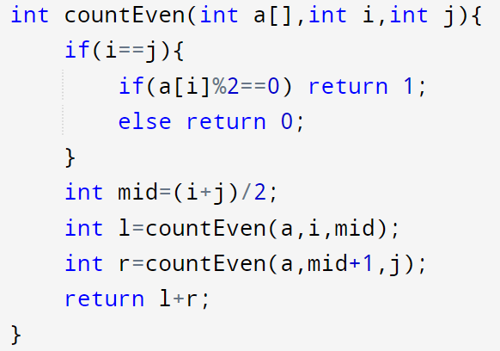
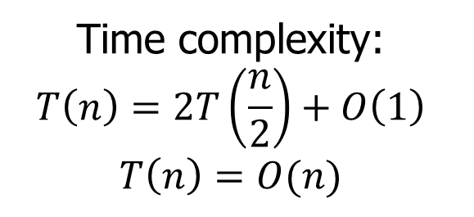
Count even numbers
Count the even numbers in an array using divide and conquer technique.
Write a pseudocode and simulate it.
Also find the time complexity.
Time complexity:
$$T\left(n\right)=2T\left(\frac{n}{2}\right)+O\left(1\right)$$
$$T\left(n\right)=O(n)$$

Slide 45
Conclusion: Divide-and-Conquer
This Divide and conquer algorithm is clearly substantially faster than any of the brute-force methods. It required some cleverness, and the programming is a little more complicated – but the payoff is large.
Divide and conquer is just one of several powerful techniques for algorithm design
Divide-and-conquer algorithms can be analyzed using recurrences
Can lead to more efficient algorithms

